Slide 1
High-throughput and Adaptive Feedback Microscopy
Christian Tischer, Sabine Reither, Volker Hilsenstein, Beate Neumann, Rainer Pepperkok
Advanced Light Microscopy Facility, EMBL Heidelberg
Meyerhofstr.1, 69117 Heidelberg, Germany
High-throughput microscopy of siRNA treated cells has become a standard tool for discovering genes with roles in specific biological processes. However, conducting high-throughput microscopy experiments is still challenging as it puts high demands on sample preparation, microscopy, image and data analysis. Moreover, further characterization of the “hit genes” often requires demanding microscopic assays that are difficult to perform even in medium throughput. In this talk, I will outline the typical challenges occurring in high-throughput microscopy and discuss how dedicated microscope systems can help to tackle these challenges. In addition, I will describe how “adaptive feedback microscopy” allows scientist to perform highly complex microscopic assays in a fully automated manner, thereby enabling detailed and systematic further investigation of the identified “hit genes”.

Slide 2
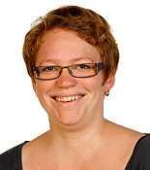
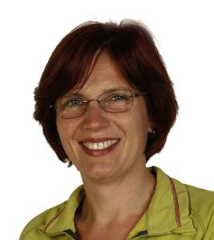
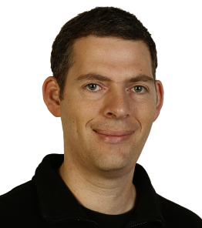
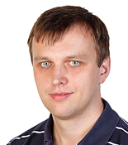
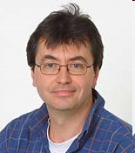
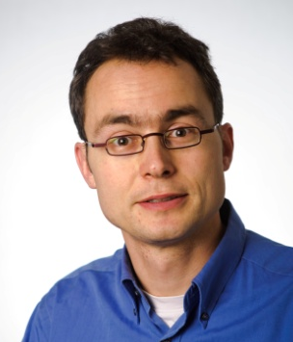
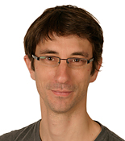
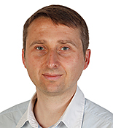
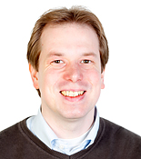
Advanced Light Microscopy Facility (ALMF) at EMBL Heidelberg, Germany
High-Throughput Microscopy
Advanced Light Microscopy Facility
Head of Facility
Sabine Reither
Beate Neumann
Stefan Terjung
Aliaksandr Halavatyi
Rainer Pepperkok
Volker Hilsenstein
Christian Tischer
Tobias Rasse
Marko Lampe
Around 30 microscope systems
Since 1998 serving EMBL scientists and international visitors

Slide 3














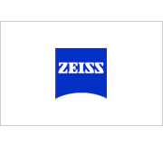



Current Industrial Partners of the ALMF (in alphabetical order)
This talk

Slide 4

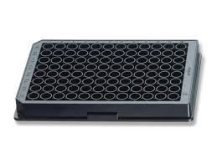

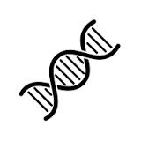

A ‘typical’ HT-microscopy experiment
Cell-biological question
Bio-informatic filter
~500 genes of interest
~1500 siRNAs (3 per gene)
~54 96-well plates (3 replicates)
~40000 images (2 channels, 4 positions per well, 20x lens)
Image analysis of ~4 million cells
Few “hit” genes that show biological effect

Slide 5
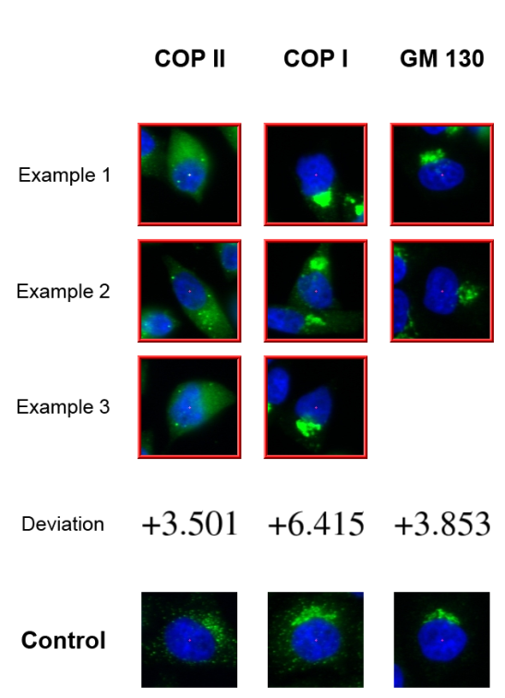
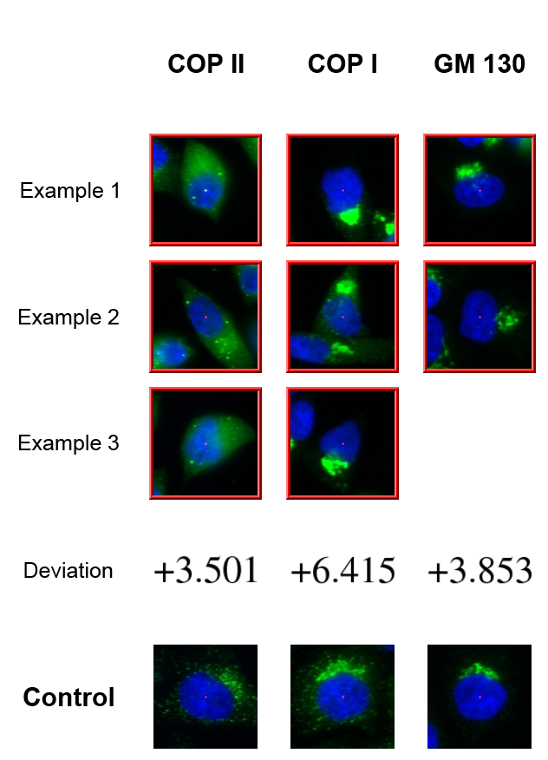
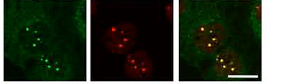
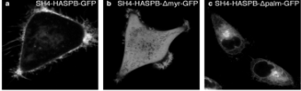
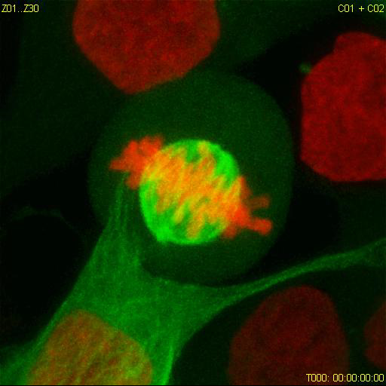
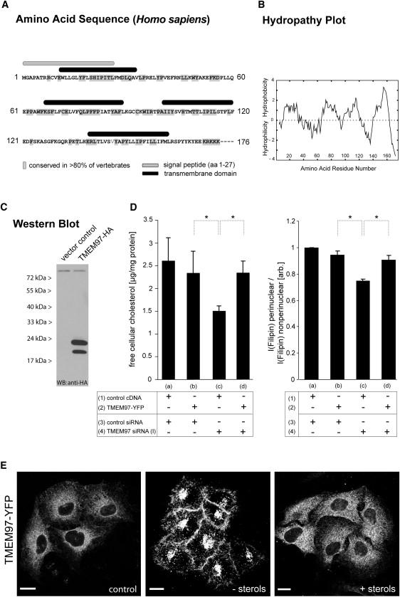
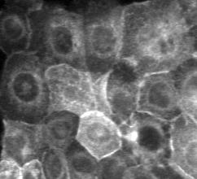
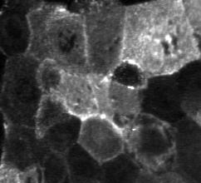
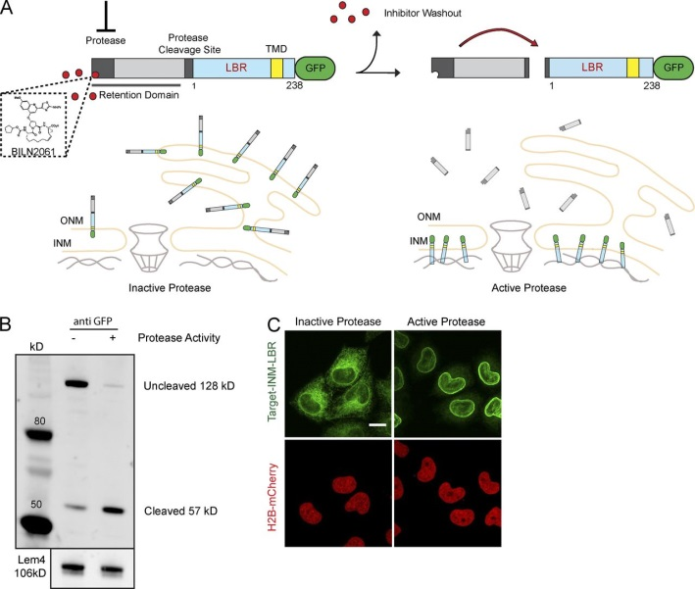
Completed HT-microscopy projects with ALMF support
Protein secretion / membrane
trafficking / organelle organisation
Simpson et al., Nat Cell Biol. 2012
DNA repair
Gudjonsson et al., Cell 2012
Lukas et al., Nat Cell Biol. 2011
Doyle et al., Cell. 2009
Plasma membrane targeting
Ritzerfeld et al., Genome Research 2011
Cell division
Neumann et al., Nature 2010
Cholesterol metabolism
Bartz et al, Cell Metab. 2009
Blattmann et al., PloS Genet 2013
Cystic Fibrosis
Almaca et al., Cell 2013
Inner membrane nuclear targeting
Boni et al. J Cell Biol 2015
Notes:
RNAi microarrays are Here you can see the summary of projects using RNAi microarrays.
All projects labelled in red were genome-wide screens.
These RNAi microarrays can be used for many different assays types as shown here.

Slide 6
Microscope system considerations

Slide 7



Multi-color Imaging Modalities
Halogen
lamp
LED
~ 1 ms
Multi-band dichroic
Filter cube
>>100 ms
Emission filter wheel >10 ms
Faster, no crosstalk
LED
~ 1 ms
Multi-camera solutions….
$$$
Multi-band dichroic
Crosstalk?!
Multi-band emission filter

Slide 8
Auto-focus modalities
“Software” autofocus
“Hardware” autofocus
Looks for reflection of (infrared) light from the glass- or plastic-bottom
Modern systems <<1s

Slide 9
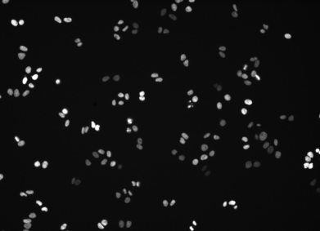
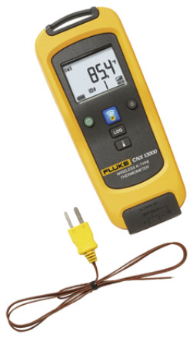
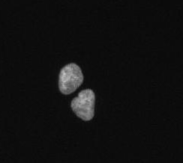
Environmental control
38C => visible mitotic defects
(e.g., increased mitotic index and micro-nuclei formation)
37C ?!
37C ?!
37C ?!
Zeiss CellDiscoverer 7, 10x, every 30min, 48h
H2B-mCherry
Cropped and enlarged view on above movie

Slide 10
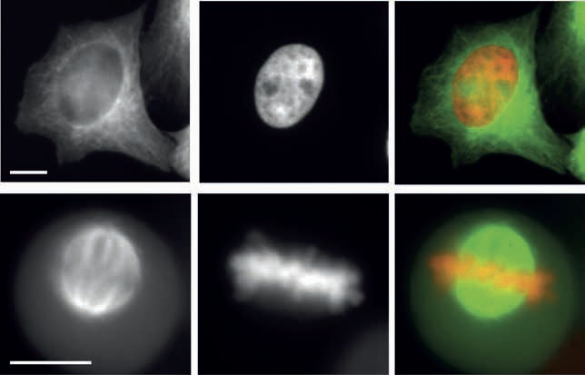
Cell Culture
GFP-Tubulin
DNA (Hb2-mCherry)
Merge
Picture multi-well plate
Prices for glass-bottom >10$
And plastic-bottom <2$
Plastic bottom:
- Better compatible with some cell culture
Interphase
$$$
Mitosis
Celldiscoverer 7
logo
Fig. 2: Double colour imaging in plastic cell culture plates.
HeLa-Kyoto cell stably expressing H2B-mcherry and GFP-tubulin were cultured in a
plastic cell culture plate from NUNC, fixed and subsequently imaged using a 20x/0.75NA
objective with a magnification changer 2. (A,D) GFP-tubulin, (B,E) H2B-mcherry, (C,F)
overlay image (GFP-tubulin shown in green and H2B-mcherry in red). Scale bar 10 μm.
Todo: check effective NA=40x/0.75?

Slide 11
Multi-well Transmission Imaging
Brightfield contrast
Condenser lens
“Phase gradient contrast”
!
!
CellDiscoverer 7, 5x magnification

Slide 12
Assay development considerations

Slide 13
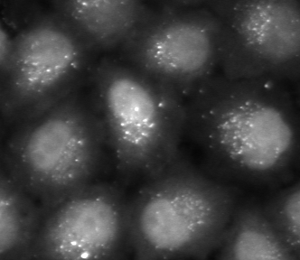
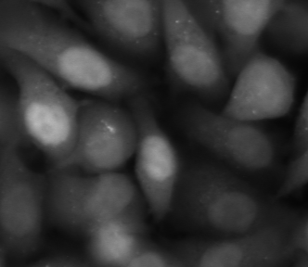
Autophagosome screen
Treatment A
Treatment B
In principle, the total intensity inside all dot-like structures
in each cell is proportional to the amount of protein recruited
to autophagosomes in this cell.

Slide 14
Acquisition modalities: confocal
10 um
z
Point scanning confocal
Spinning disc confocal
Typically too slow
and not necessary
Can be fast enough,
but 3-D data
and 3-D analysis
(on-the-fly) sum projection

Slide 15
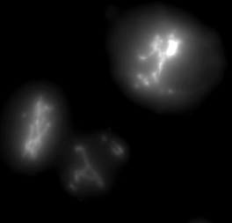
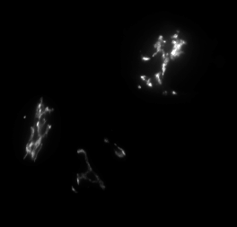
Acquisition modalities: widefield
Zeiss
CellDiscoverer 7
Hela cell
Golgi-GFP
z-stack, dz=1um
Deconvolution
Inside ZEN Blue acquisition software
Widefield NA0.9
(on-the-fly) deconvolution and sum projection

Slide 16
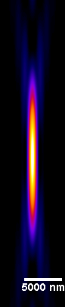
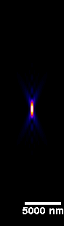
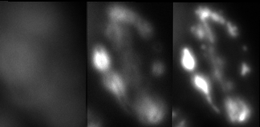
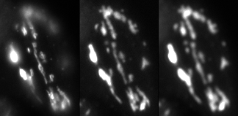
Low NA widefield imaging
NA 0.3
NA 0.9
Hela cell, Golgi-GFP
z-stack, 1um steps
CellDiscoverer 7, Zeiss
z
Widefield NA0.3
Single image
NA 0.8
80 ms
30% light
NA 0.35
150 ms
40% light
NA 0.26
380 ms
80% light

Slide 17
Advice
High-throughput screening microscopy is not about pretty 3-D pictures but about fast and manageable measurements.
Typical: 100x Oil lens confocal z-stacks => Single plane 20x Air lens

Slide 18


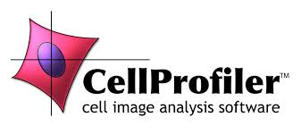
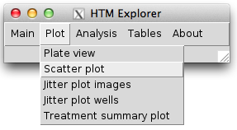

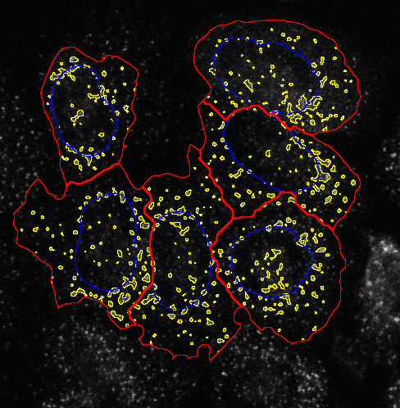
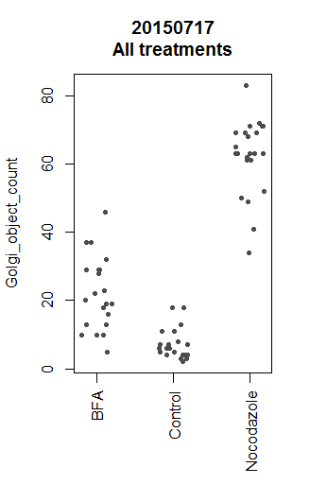
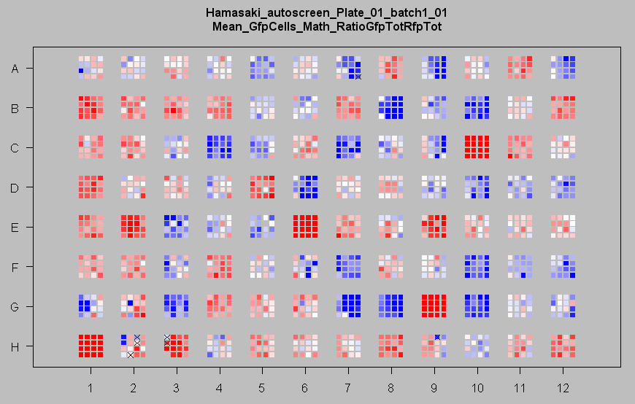
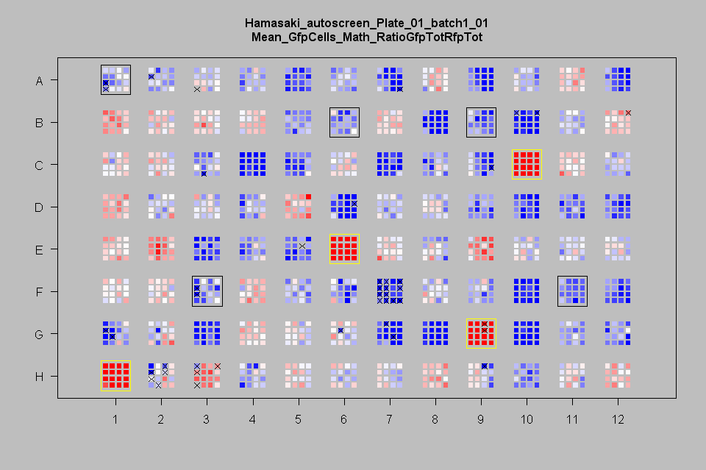
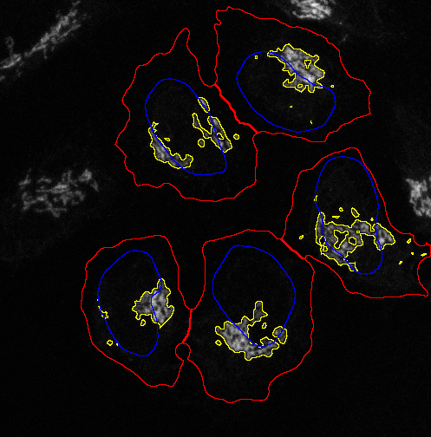
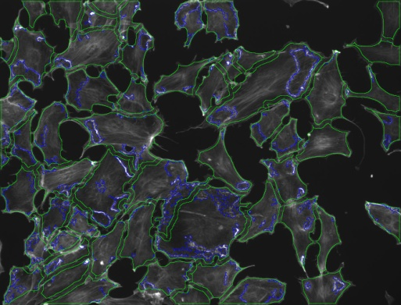
Image analysis
Visual inspection and Statistics
Linux Compute Cluster
20000 image sets
=> 1000 parallel jobs
20 image sets per job
40 min total analysis time
!!!
+
+

Slide 19
Hit list of genes … and now?
…
“Secondary” screen

Slide 20
Secondary Screens

Slide 21

Intelligent Microscopy [Conrad et al.] Adaptive Feedback Microscopy [Tischer et al.] Smart Microscopy [Huisken et al.] Open Application Development (OAD) [Zeiss]
Todo:
add references
Look for more synonyms
Sent new microscope settings
Analyze data to derive adapted microscope settings

Slide 22
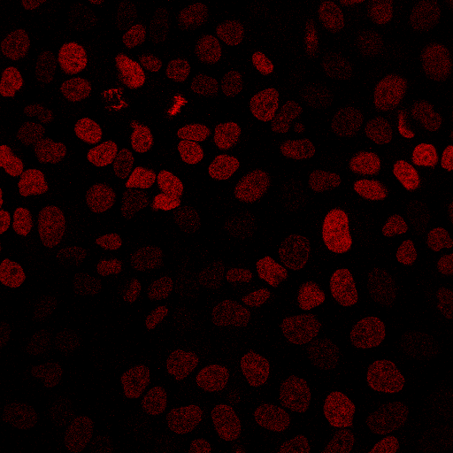
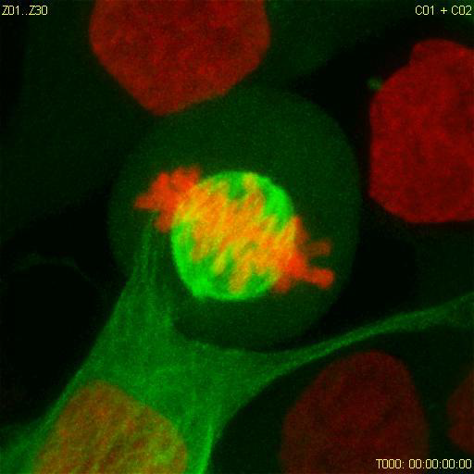
High-resolution Adaptive Feedback Time-lapse Imaging of Mitosis
Move to pre-defined position
Acquire low-res image
H2B-mCherry
Single plane
x, y
x=150 y=80
Zoom in on target object
Acquire high-content data

Slide 23
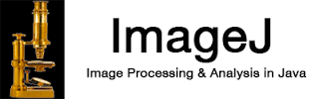
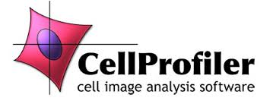
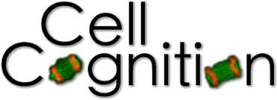
Zeiss AIM (LSM 510) (1)
Zeiss ZEN Black (e.g., LSM 780, LSM 880)
Visual Basic Programming Interface
Todo:
add references
Look for more synonyms
ImageJ
CellProfiler
CellCognition
(1) Rabut and Ellenberg, Automatic real-time three-dimensional cell tracking by fluorescence microscopy. J. Microscopy, 2004

Slide 24
Adaptive FRAP Microscopy
Move to next grid position
Zeiss LSM780
Visual Basic
ImageJ
Hundreds of experiments fully automated over night

Slide 25
Adaptive FCS Microscopy

Slide 26
Zeiss ZEN Blue (e.g., LSM 800, CellDiscoverer 7)
Python Programming Interface
Zen Blue Image Analysis Modules
Todo:
add references
Look for more synonyms
ImageJ
CellProfiler
CellCognition

Slide 27
Automated Immersion System
Both FRAP and FCS typically require high NA imaging => Objective Lenses with Immersion

Slide 28
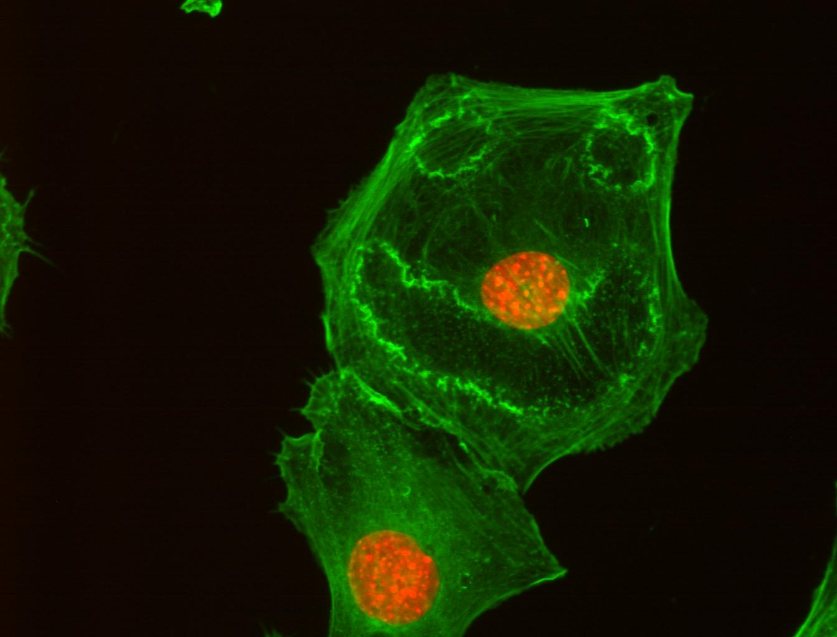
Acknowledgements
ALMF team:
Beate Neumann
Sabine Reither
Volker Hilsenstein
Yury Belyaev
Stefan Terjung
ALMF alumni
Christian Conrad
Jutta Bulkescher
FCS:
Malte Wachsmuth
Frank Sieckmann (Leica)
Zeiss LSM780 automation:
Gwen Rabut, Annelie Wuensche, Antonio Politi
Jan Ellenberg
Rainer Pepperkok
Green: actin cytoskeleton
Red: nucleus
Cells treated with PDGF

Slide 30
What to measure
Mean vs Sum
Cell cycle example

Slide 31
High-throughput Screening Microscopy
“Primary” screen
Protein knockdown by siRNA
Monitor perturbation of biological process in microscopy assay
Biological process
Protein localization dynamics
Which proteins?
Protein-protein
Interaction dynamics
“Secondary” screen
“Secondary” screen
Notes:
You have an assay that tells you whether the process of interest is working and then you look in the presence of siRNAs whether the process is still working.

Slide 32
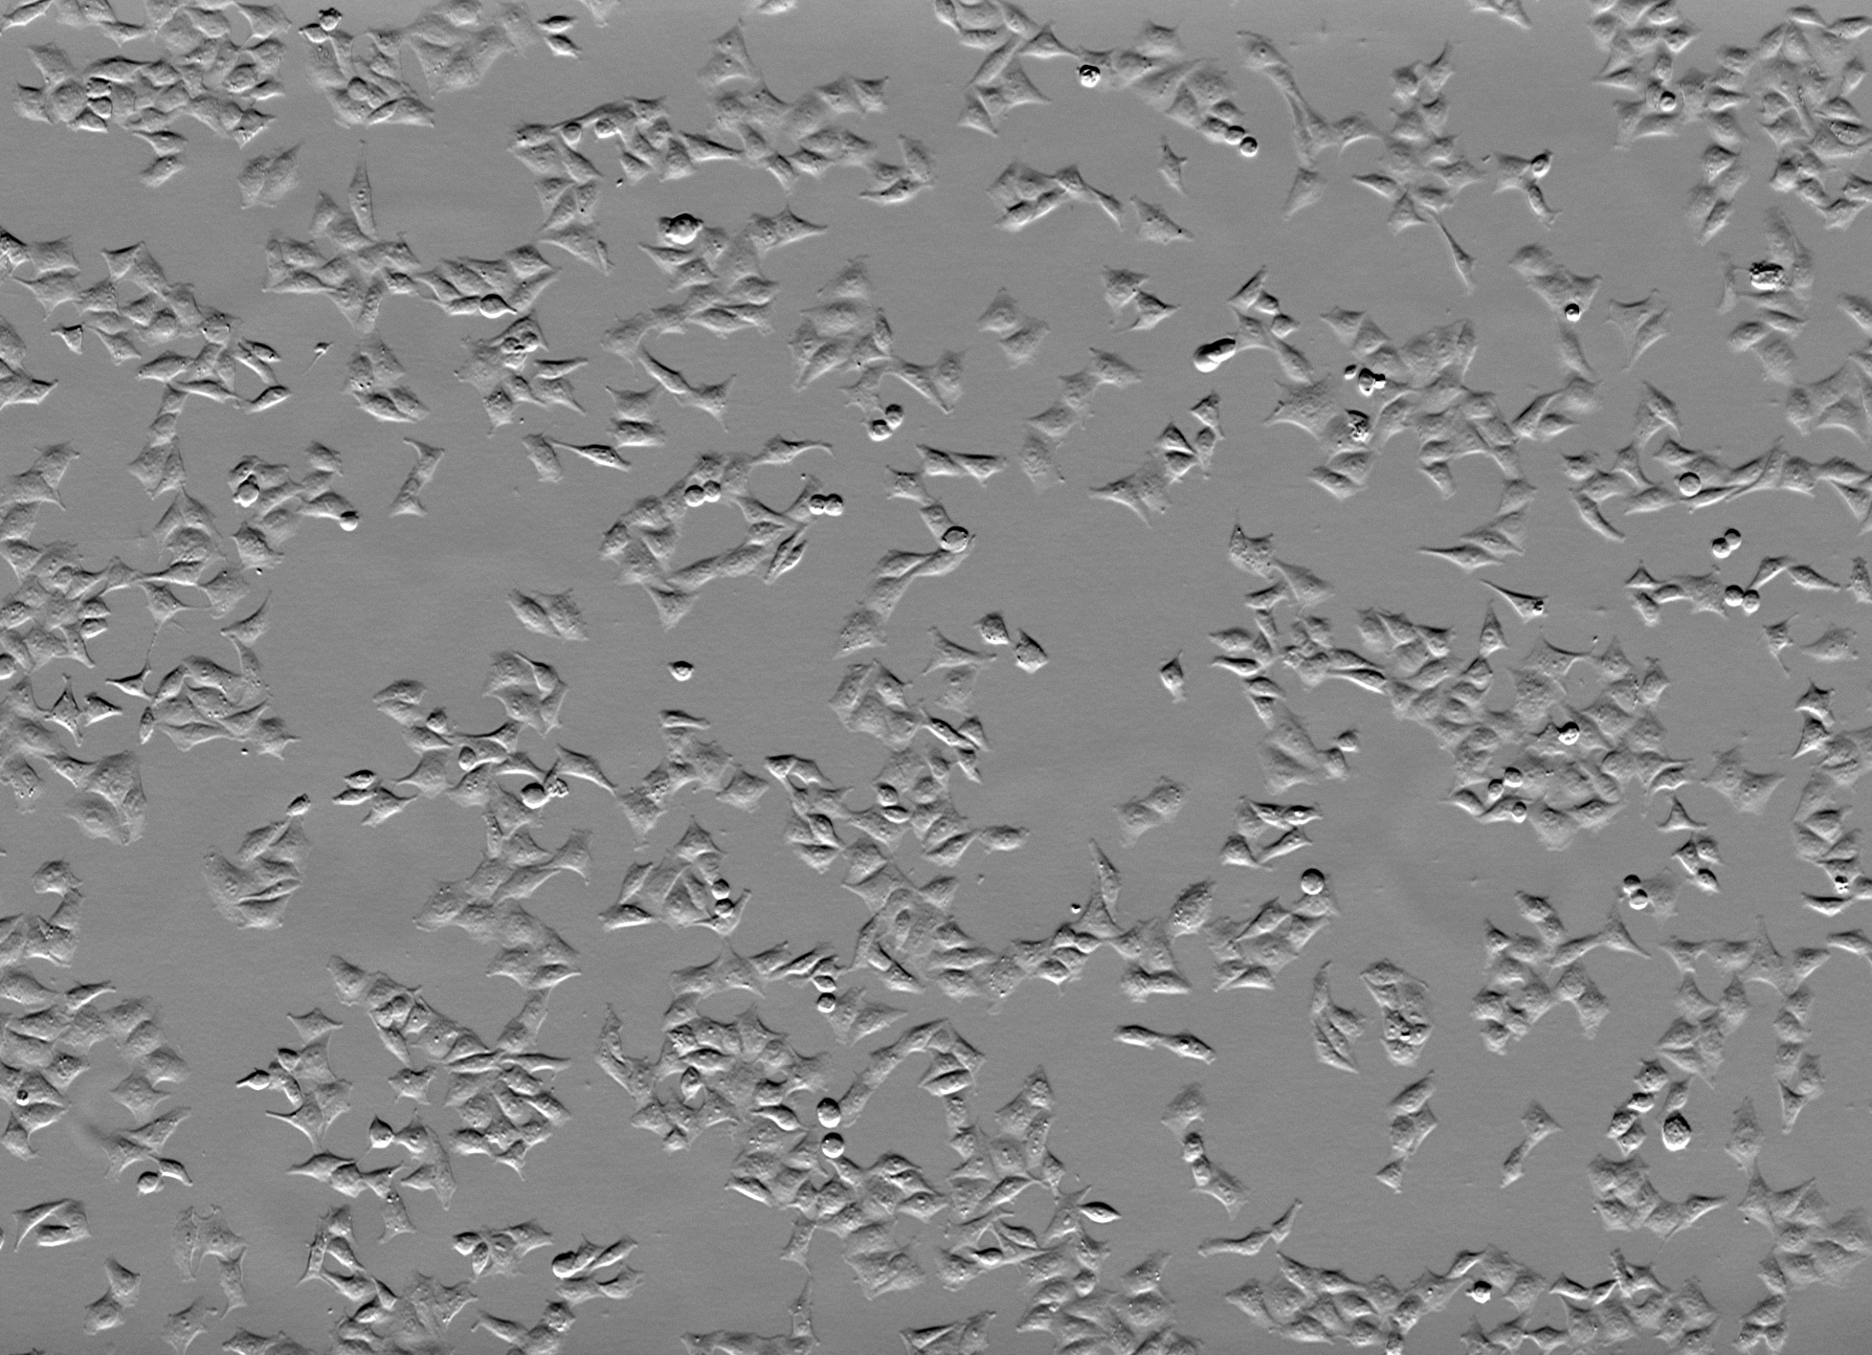
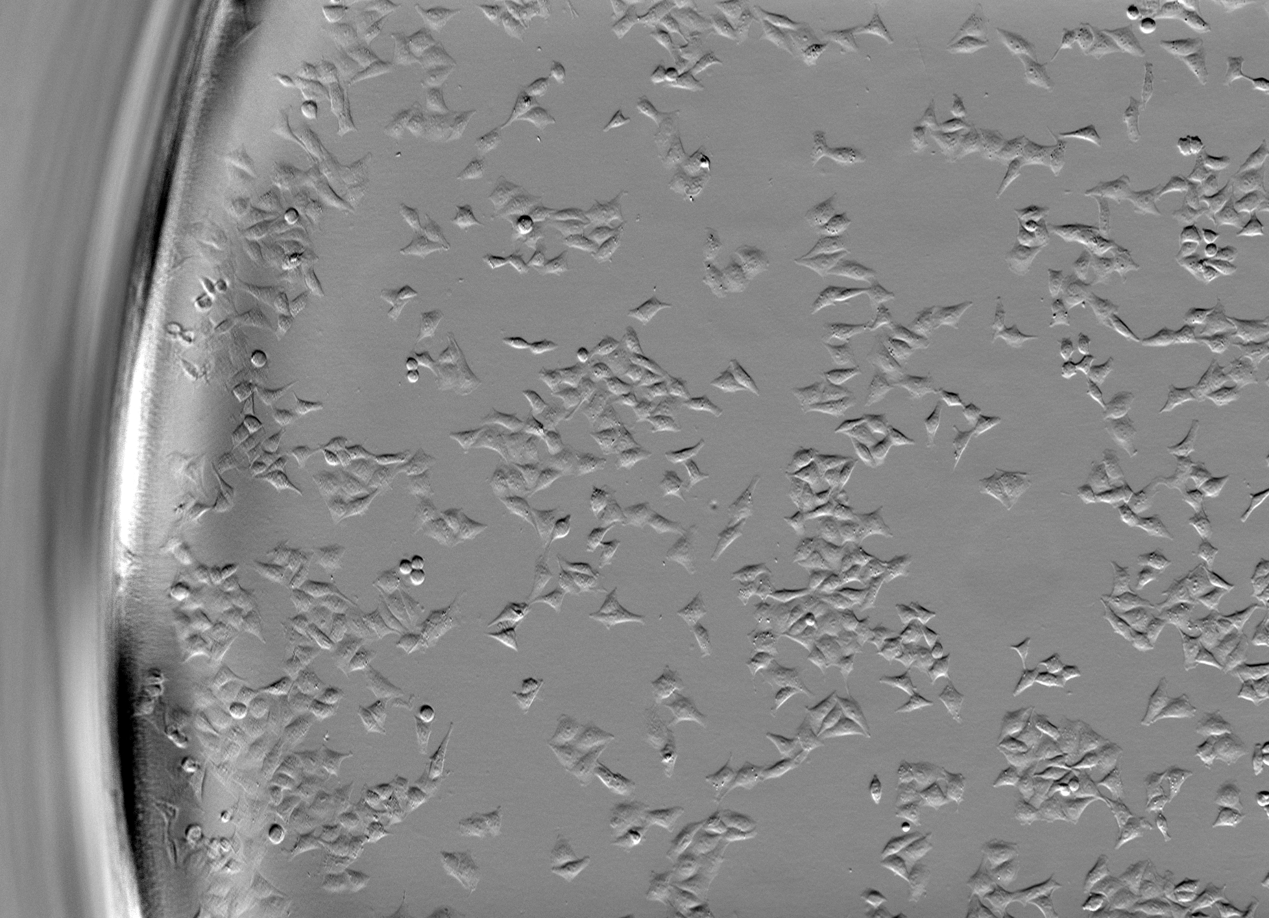
Low NA Transmission Imaging
Condenser Aperture
Celldiscoverer 7
logo
Image without shadows
Image without shadows

Slide 33
Adaptive Feedback Microscopy using ZEISS products
Microscope Examples | Zeiss Software | Open Application Development Modality | Image Analysis Modalities
LSM510 confocal (1) LSM780 confocal LSM880 confocal | ZEN Black | Visual Basic scripting with macro recording | Visual Basic or external software
LSM800 confocal CellDiscoverer 7 widefield | ZEN Blue | Python scripting with macro recording | ZEN Blue interal image analysis or external software
(1) Rabut and Ellenberg, Automatic real-time three-dimensional cell tracking by fluorescence microscopy. J. Microscopy, 2004

